Slide 1
ANALYSIS OF THE AI JOB MARKET BY ARNOLD OGUDA AGENDA 4 Research Questions Methodology Key Insights and Trends ML Models Limitations Conclusions

Slide 2
METHODOLOGY
Tools and Techniques
Data Preparation and Processing
The data was checked for missing values and duplicates of which there were none.
Python
Pandas and NumPy: data operations
Matplotlib and Seaborn: visualization

Slide 3

QUESTION 1: How do AI job salaries vary across regions, industries and remote friendliness?
For this research question I carried out the following analyses:
Regional salary comparisons
Industry-wise salary distributions
Salary comparisons on remote friendliness of jobs
Correlation between remote friendliness and location or industry

Slide 4
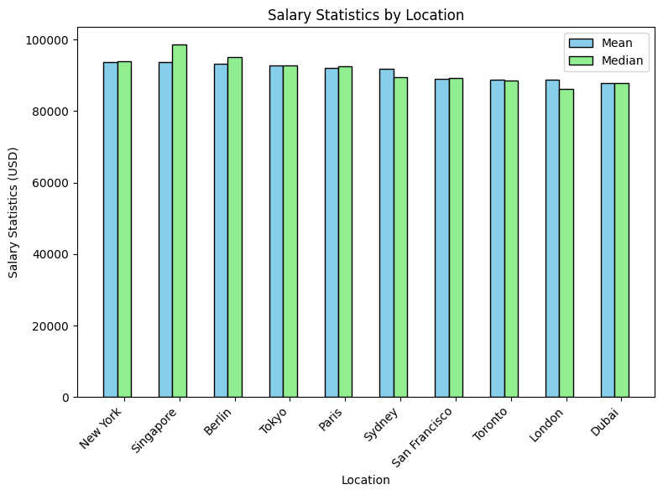
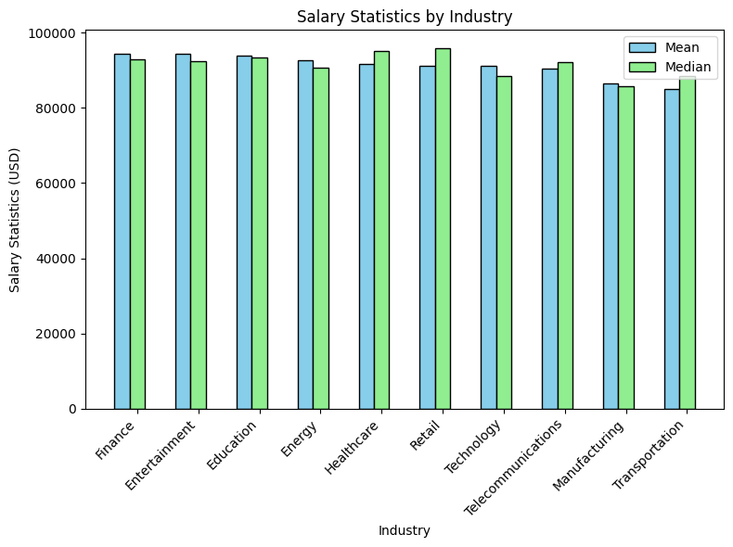
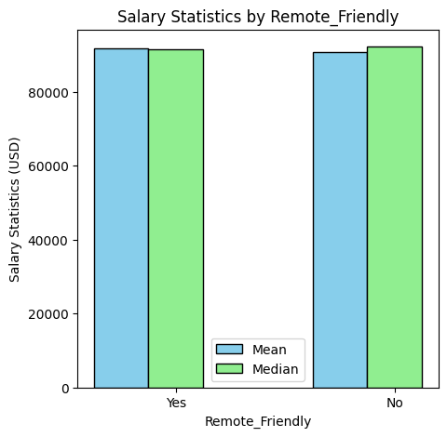
QUESTION 1 KEY FINDINGS
The range of mean salaries is not big, but New York has the highest salaries while Dubai has the lowest.
- Finance industry leads with the highest average salary in AI jobs while Transportation industry trails. However, transportation also has less entries.
Remote jobs offer a bit more salary

Slide 5
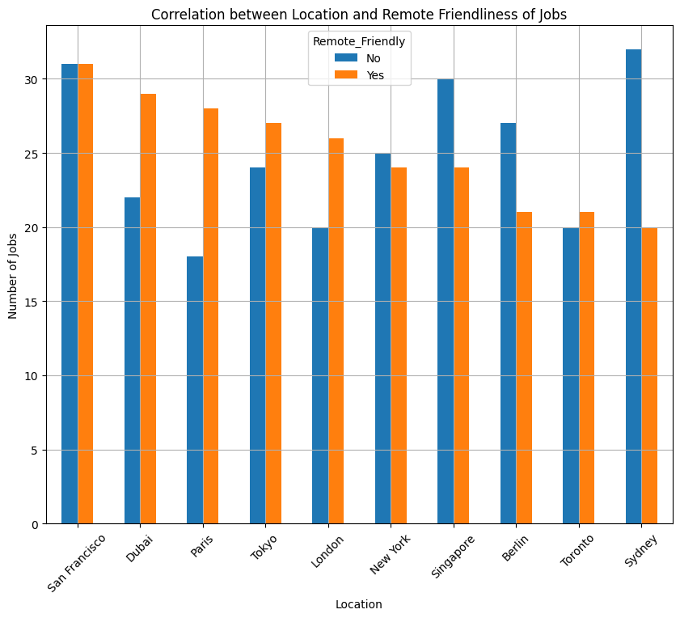
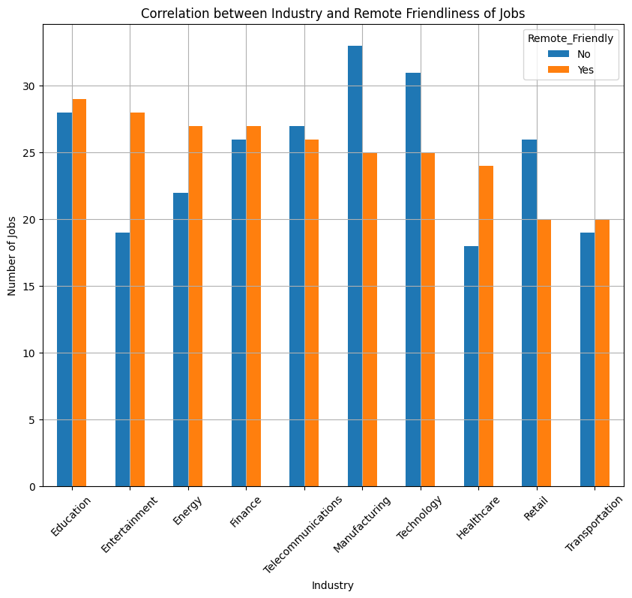
Entertainment and Healthcare stand out with the highest percentages of remote-friendly positions (around 60% and 57% respectively)
2. Manufacturing and Retail have the lowest (around 43% each)
3. Most of the other industries have a relatively balanced split, showing higher acceptance of remote jobs.
1. San Francisco shows an even 50-50 split between remote and non-remote jobs while still being the highest in number of remote job opportunities.
2. Sydney has the lowest proportion of remote-friendly jobs while still leading in non-remote opportunities

Slide 6
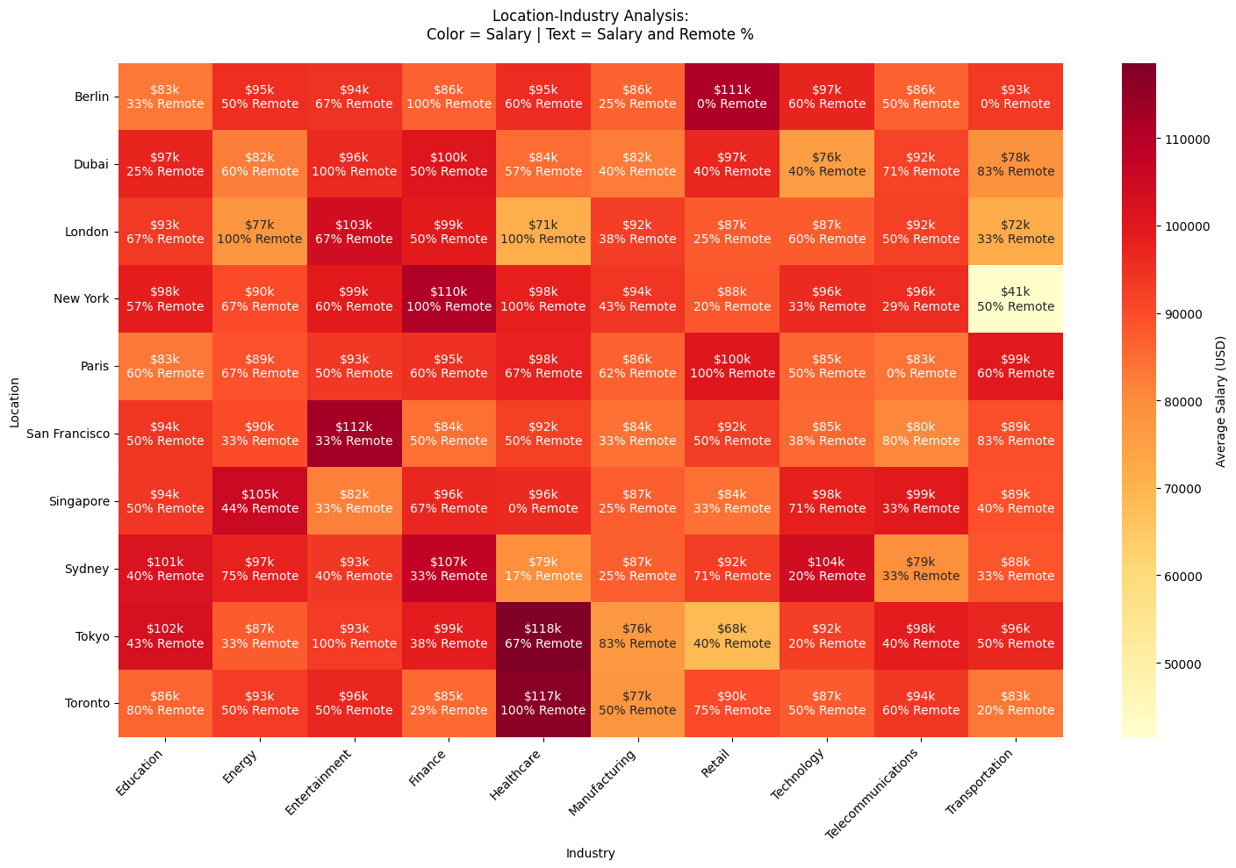
The best combination for industry, location and remote friendliness in descending order are:
1. A remote job in Tokyo in Healthcare - $118k
2. A remote healthcare job in Toronto - $117k
3. A non-remote job at San-Francisco in Entertainment - $112k
4. A non-remote job in Berlin in the Retail industry - $111k

Slide 7

QUESTION 2:WHAT INDUSTRIES ARE LEADING AI ADOPTION AND HOW DOES THIS AFFECT JOB DEMAND AND AUTOMATION RISK?
For this research question I carried out the following analyses:
Industries and their levels of AI Adoption
Automation Risk for each Industry
Testing correlation between AI adoption and job demand (using Chi-Square Test)
Job growth projections for each industry

Slide 8
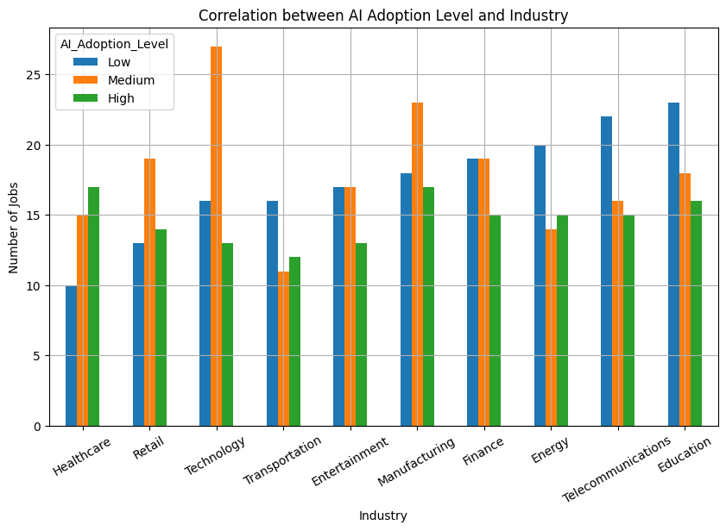
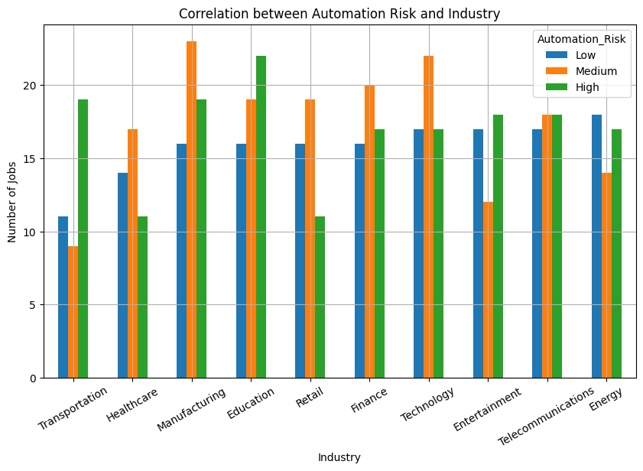
1. Healthcare and Manufacturing have the highest adoption level of but Healthcare seems to be moving towards it more than Manufacturing i.e., the rising trend.
2. Technology is the industry using the most AI.
- Education and Manufacturing have the relatively highest automation risk while Transportation has the lowest.

Slide 9
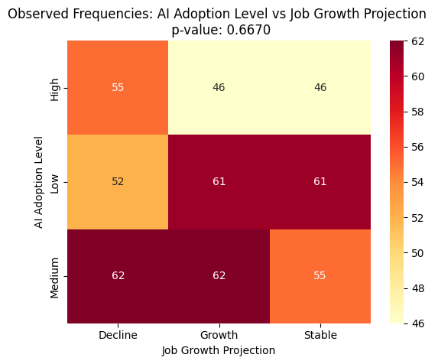
Null Hypothesis: There is no association between AI adoption level and job growth projection.
Alternative Hypothesis: There is an association between AI adoption level and job growth projection.
Conclusions after the Chi-Square Test
- With a p-value of 0.667, we fail to reject (i.e., agree with) the null hypothesis. This means there is no evidence of a significant relationship between AI adoption levels and growth projections.
- This implies that the distributions are more likely due to chance rather than a meaningful association

Slide 10
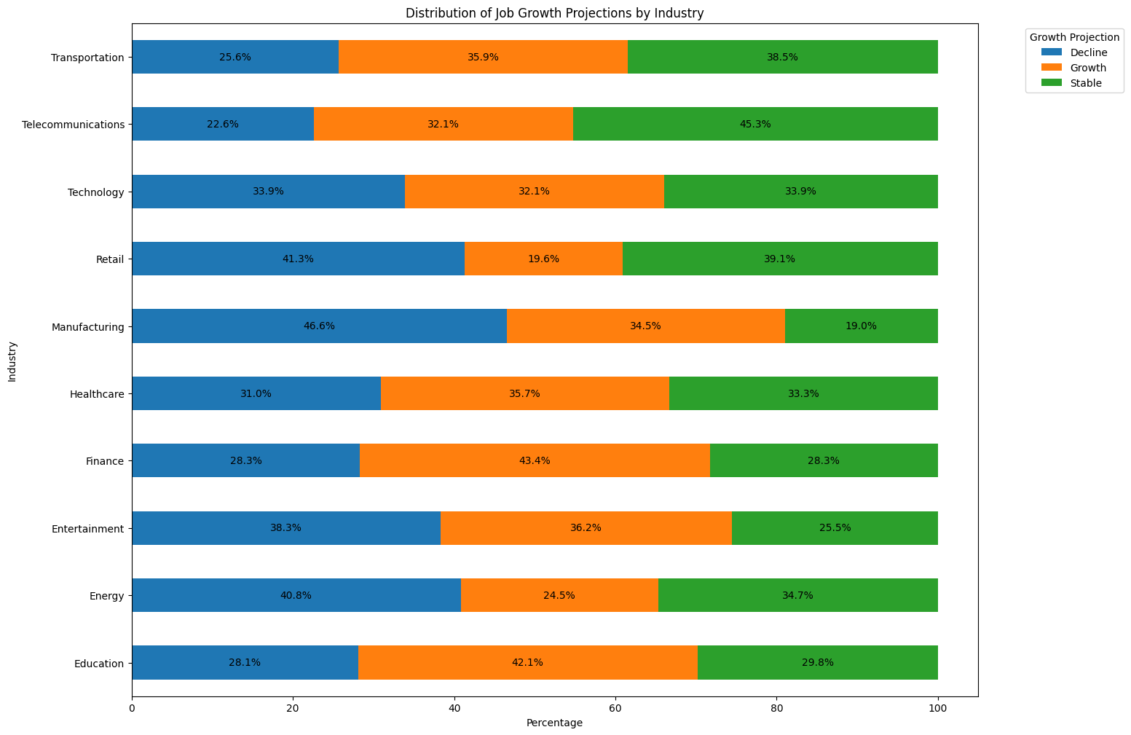
1. There is a decline in jobs in the Manufacturing industry as the AI adoption grows.
2. Telecommunication jobs remain the most stable despite AI introduction.
3. Finance jobs grow more with AI introduction

Slide 11

QUESTION 3:WHAT skills are most frequently required for ai jobs and how do they vary by job title and region?
For this research question I carried out the following analyses:
Statistical analysis of skill distribution
Most demanded skills across regions
Skill requirements by job title

Slide 12
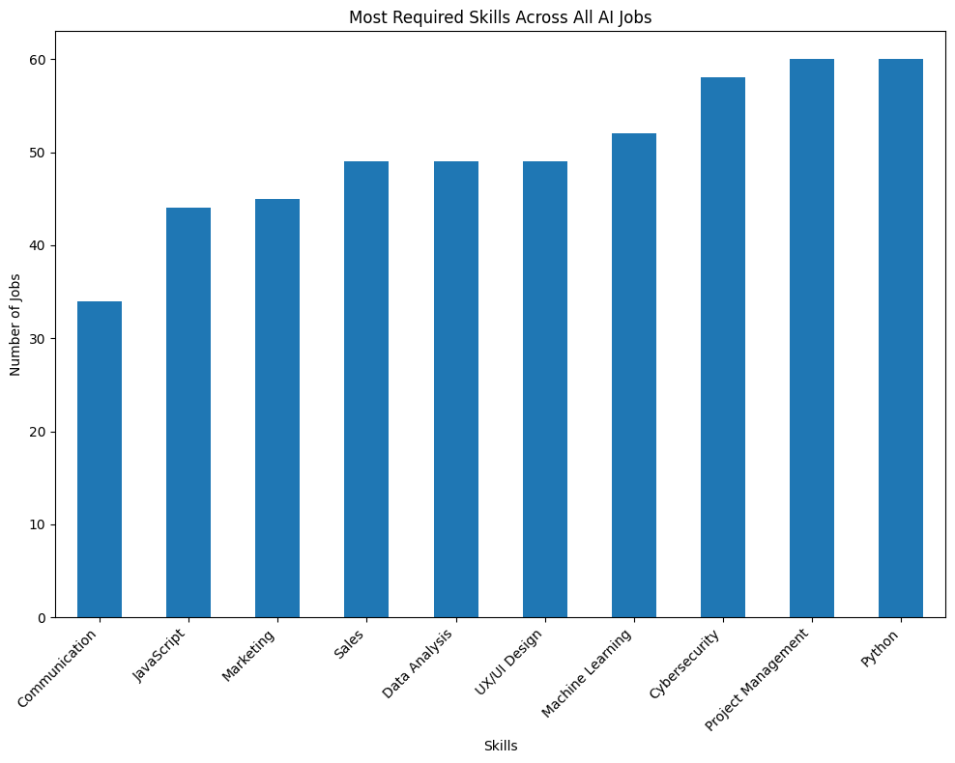
Statistical analysis of skill distribution
SKILLS NEEDED | NUMBER OF POSITIONS
Communication | 34
JavaScript | 44
Marketing | 45
Sales | 49
Data Analysis | 49
UI/UX Design | 49
Machine Learning | 52
Cybersecurity | 58
Project Management | 60
Python | 60
Showing the list of skills required in the industry and their distribution in an ascending order
- Python and Project management are the most sought-after skills while Communication is the least considered

Slide 13
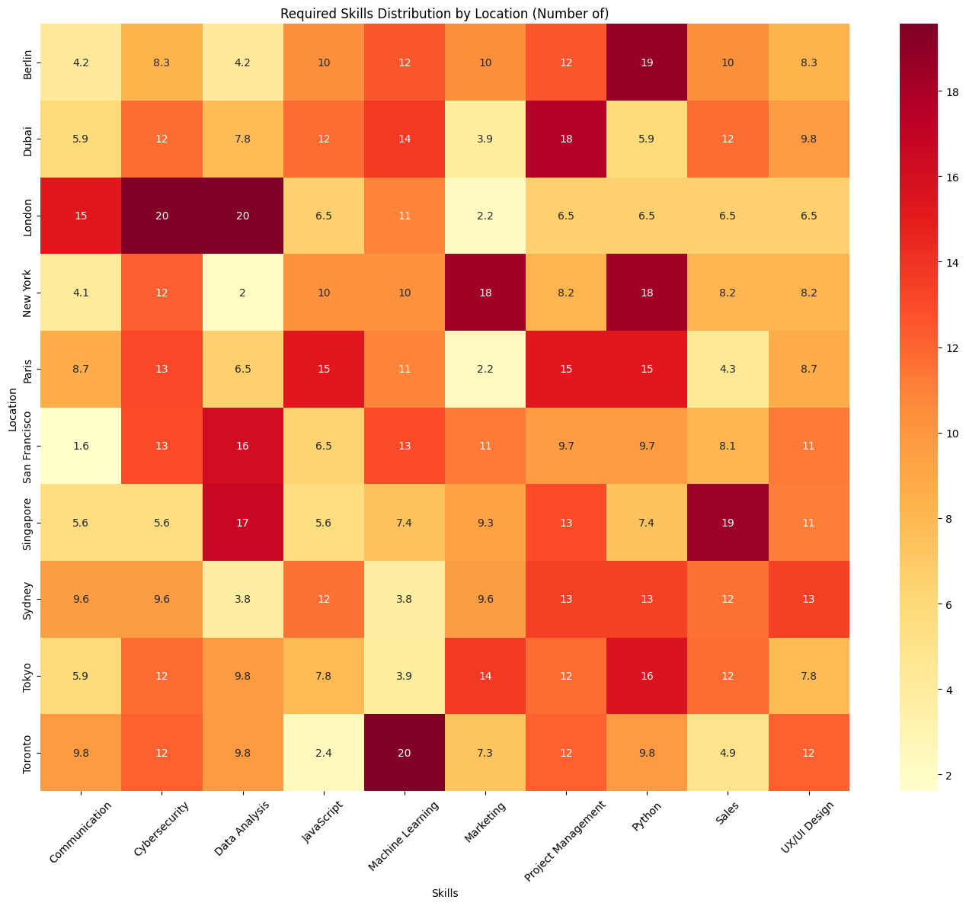
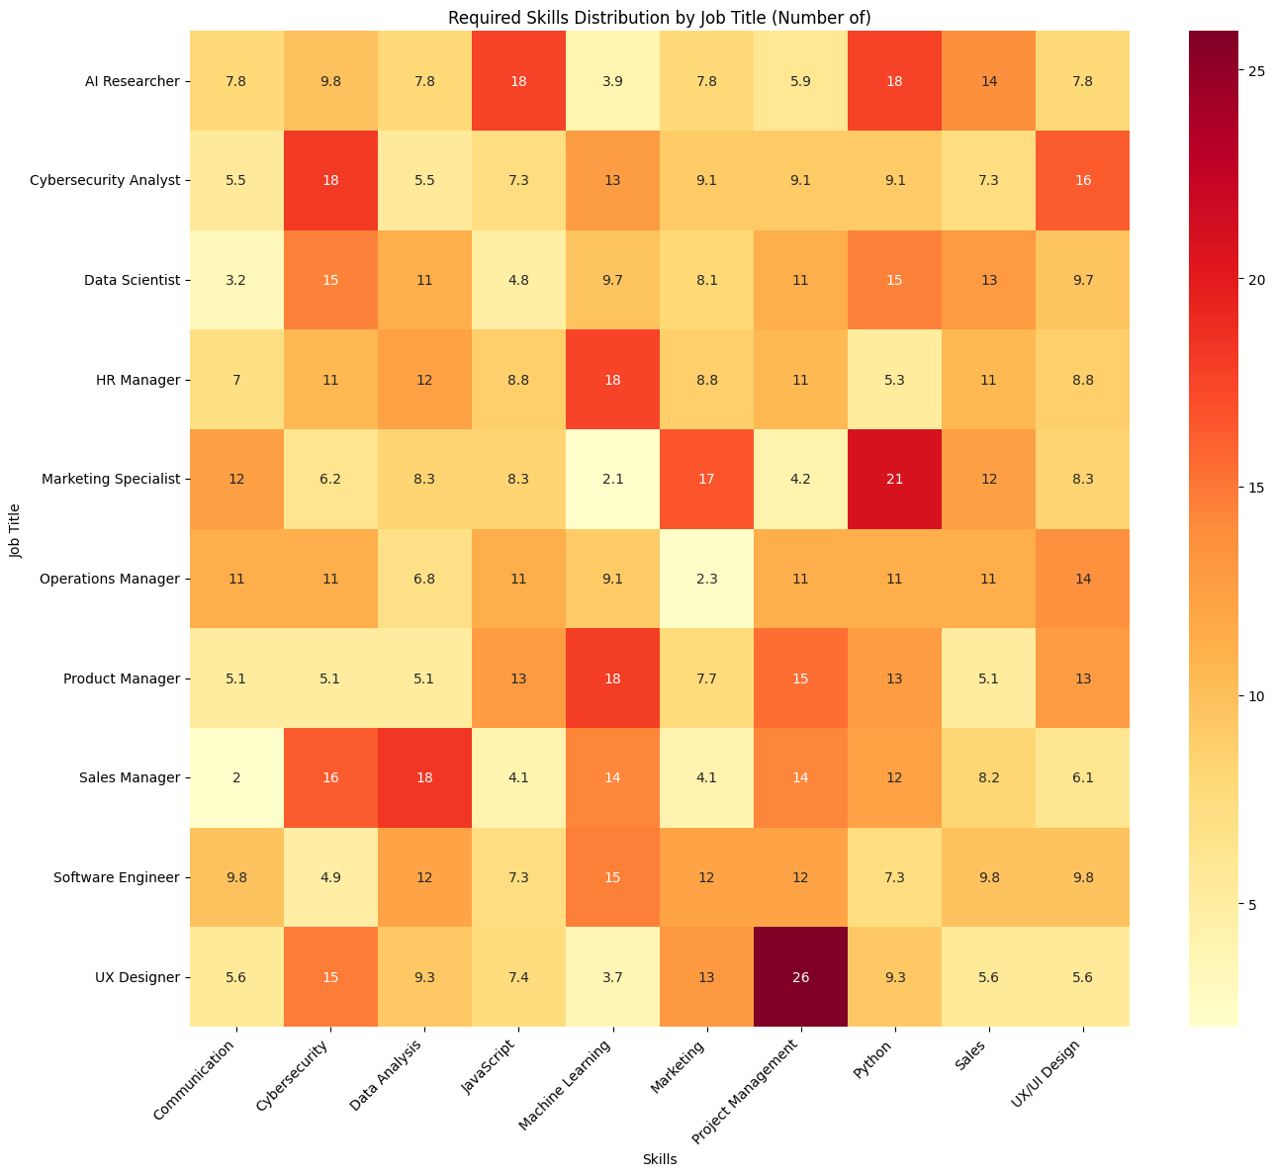
Highest demand: London-Cybersecurity and Data analysis.
Cybersecurity, Machine Learning and Project Management maintain a moderate to high demand
Project management is strongly required for UI/UX designers.

Slide 14

QUESTION 4:WHICH AI JOB ROLES ARE IN MOST DEMAND, AND HOW DO THEIR SALARIES AND JOB GROWTH PROJECTIONS COMPARE ACROSS REGIONS?
For this research question I carried out the following analyses:
Demand for different AI roles
Salary comparisons across roles
Growth projections by role and region
This Photo by Unknown Author is licensed under CC BY

Slide 15
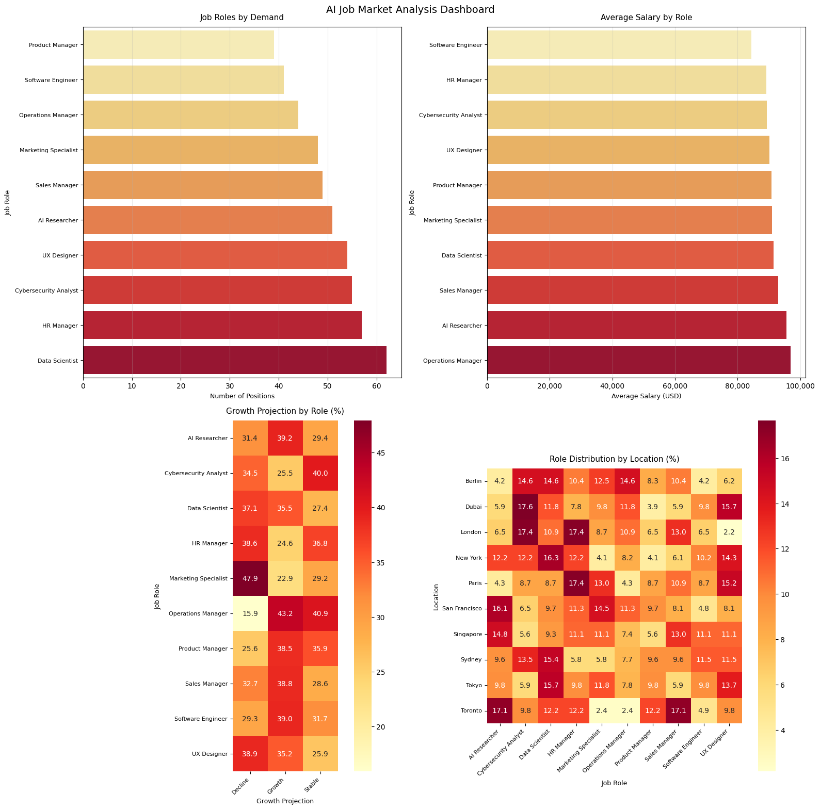
Conclusions
Data scientist roles have the most demand while product managers have the lowest demand
Operations Managers receive the highest average salary while Software engineers receive the lowest.
Marketing Specialist Jobs are on a decline while operation manger jobs are growing in stability.
Cybersecurity analysts have the most job stability in places like Dubai and London

Slide 16
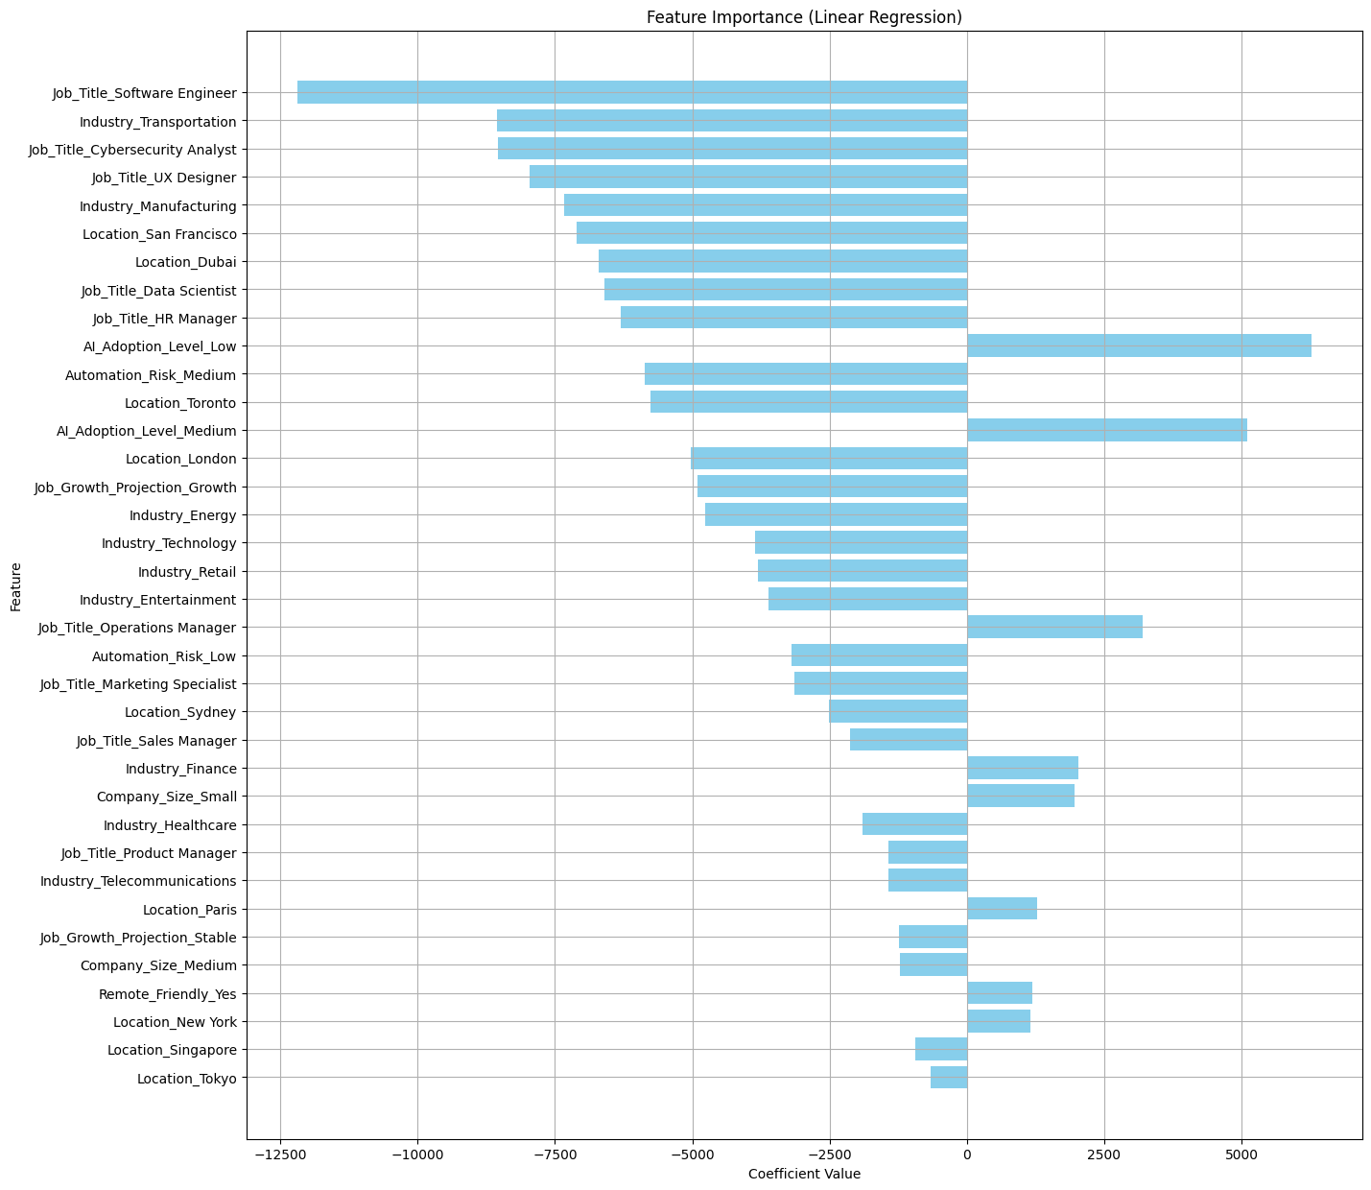
LIMITATIONS
Insufficient data for modelling
Technical skills in modelling
Model Performance Metrics:
R² Score: -0.129
Mean Absolute Error: $18,418.12
Root Mean Squared Error: $23,052.09

Slide 17
THANK YOU
Arnold Oguda
Mobile: 0792251985
Email:
ogudaarnold@gmail.com
arnold.oketch@strathmore.edu
GitHub Project Link: https://github.com/Arnold-18-CS/AI-Job-Market-Data-Analysis

